Slide 1

SOFTWARE DESIGN
AND ARCHITECTURE
(SDA)
Chapter 5: Principles of Detail Design
UTM KUALA LUMPUR

Slide 2
01
DETAIL DESIGN
04
DETAIL DESIGN PRINCIPLE
Overview and Principle of Detail Design
OCP, LSP and ISP.
02
KEY TASKS DETAIL DESIGN
Understanding, Creating, Evaluating, Documenting and Monitoring
03
INTERNAL & COMPONENT DESIGN
OO Approach

Slide 3
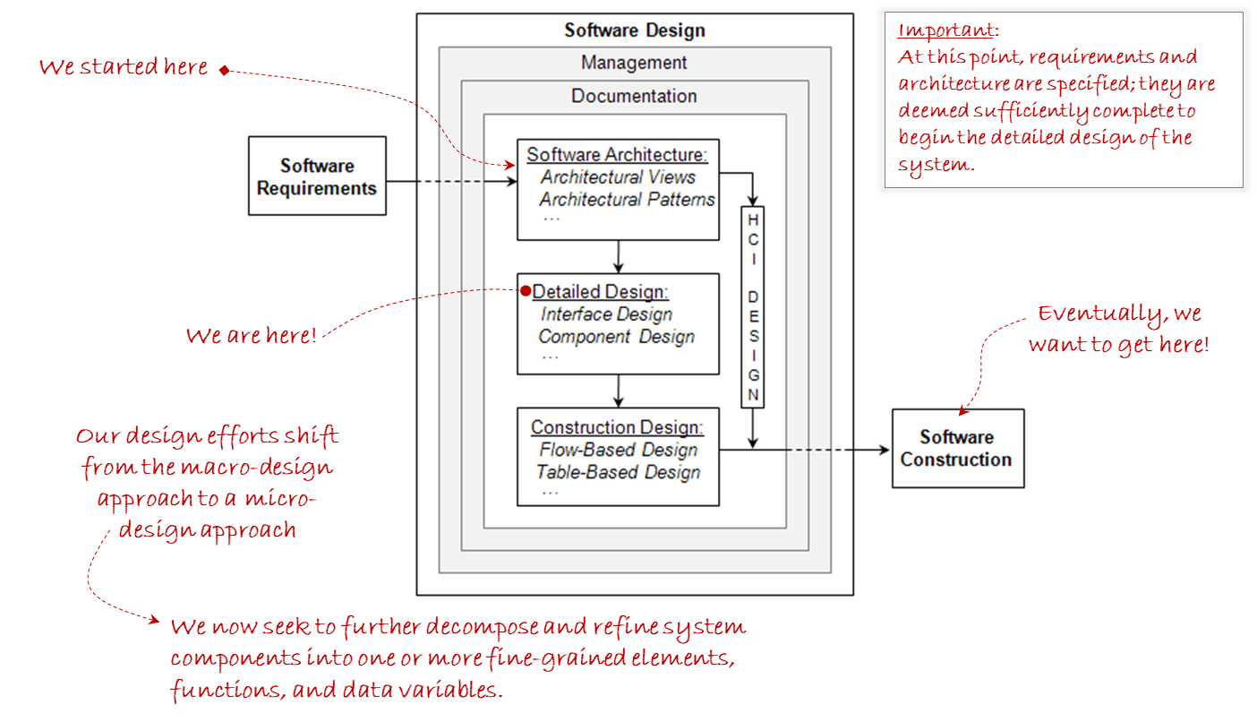
THE DETAIL DESIGN

Slide 4

ARCHITECTURAL VS DETAIL DESIGN
Aspect | Architectural Design (Style) | Detailed Design (Pattern)
Scope | Focuses on high-level system structures | Deals with specifics of individual components
Abstraction Level | Conceptual | Concrete
Granularity | Large-scale components and interactions | Finer-grained details like algorithms, data structures
Decision Making | Strategic decisions about system organization | Tactical decisions about implementation details
Focus | Performance, scalability, flexibility | Functionality and efficiency of modules
Documentation | System architecture, interfaces, interactions | Detailed design decisions, data structures, algorithms
4

Slide 5
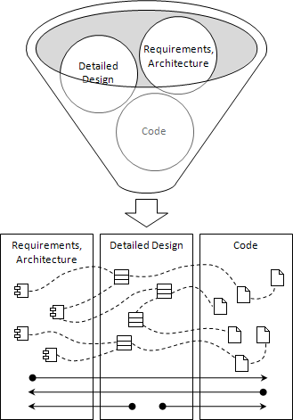
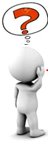
WHAT IT LOOK LIKES
Designer’s Mental Model During Detailed Design!
Important:
During detailed design, the use of industry-grade development tools are essential for modeling, code generation, compiling generated code, reverse engineering, software configuration management, etc.
If given requirements and architecture, detailed designers must move the project forward all the way to code
If given code, detailed designers must be able to reverse engineer the code to produce detailed and architectural designs.
When starting at detailed design, designers must be able to produce both code and architectural designs
5

Slide 6
THE KEY TASK IN DETAIL DESIGN
01. UNDERSTANDING REQUIREMENTS
Focus on requirements allocated to their specific components
05.MANAGING & MONITORING
Architectural to Detail
Design to Code.
01
02
02. CREATING THE DESIGN
Detailed design consist of both structural and behavioral designs, interfaces and GUI
05
03
04.DOCUMENTING
SOFTWARE DESIGN DOCUMENT (SDD)
04
03. EVALUATING THE DESIGN
Internal Technical Review.
6

Slide 7
INTERNAL & EXTERNAL COMPONENT DESIGN
01. CLASSES AND OBJECTS
Objects are instances of classes, representing real-world entities with specific characteristics and behaviors.
02. INTERFACES, TYPES, AND SUBTYPES
Interfaces define a contract for classes to implement specific methods. Subtypes inherit properties and behaviors from parent types or interfaces.
01
03
02
03. DYNAMIC BINDING
Dynamic binding allows method calls to be resolved at runtime.
04. POLYMORPHISM
Polymorphism allows objects of different classes to be treated as objects of a common superclass through inheritance
04
7

Slide 8

DETAIL DESIGN PRINCIPLE
Principle | Open-Closed Principle (OCP) | Liskov Substitution Principle (LSP)
Definition | Software entities should be open for extension but closed for modification. | Objects of a superclass should be replaceable with objects of a subclass without affecting the correctness of the program.
Focus | Emphasizes designing modules that can be easily extended with new functionality. | Focuses on ensuring that inheritance hierarchies are designed in a way that does not break the behavior of the superclass when substituting objects of its subclasses.
Objective | Promotes maintainability and extensibility by minimizing the need for modifying existing code. | Ensures that clients can use subclasses interchangeably with their parent classes, allowing for flexibility and modularity in the design.
Implementation | Achieved through techniques like abstraction, encapsulation, and inheritance. | Implemented by adhering to guidelines such as not weakening preconditions, not strengthening postconditions, and maintaining behavioral consistency in subclasses.
Example | Using abstract classes and interfaces to define contracts, allowing new implementations to be added without modifying existing code. | Ensuring that derived classes do not violate the expected behavior of the base class, such as a Square inheriting from a Rectangle without breaking the Rectangle's behavior regarding width and height relationships.
8

Slide 9
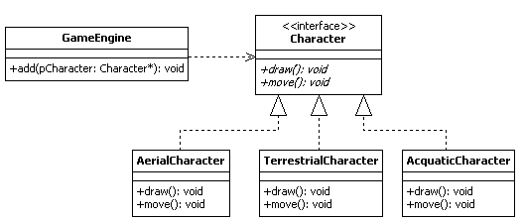

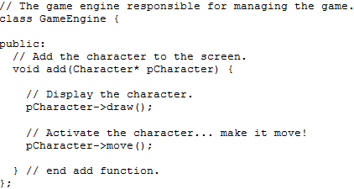
OPEN-CLOSED PRINCIPLE (OCP)
New redesign! Adheres to OCP!
Old design! Violates OCP!
New Aquatic Character added by extension and not by modifying existing working code!
With this design, GameEngine can draw and activate current and future Characters in the game without modification!
9

Slide 10
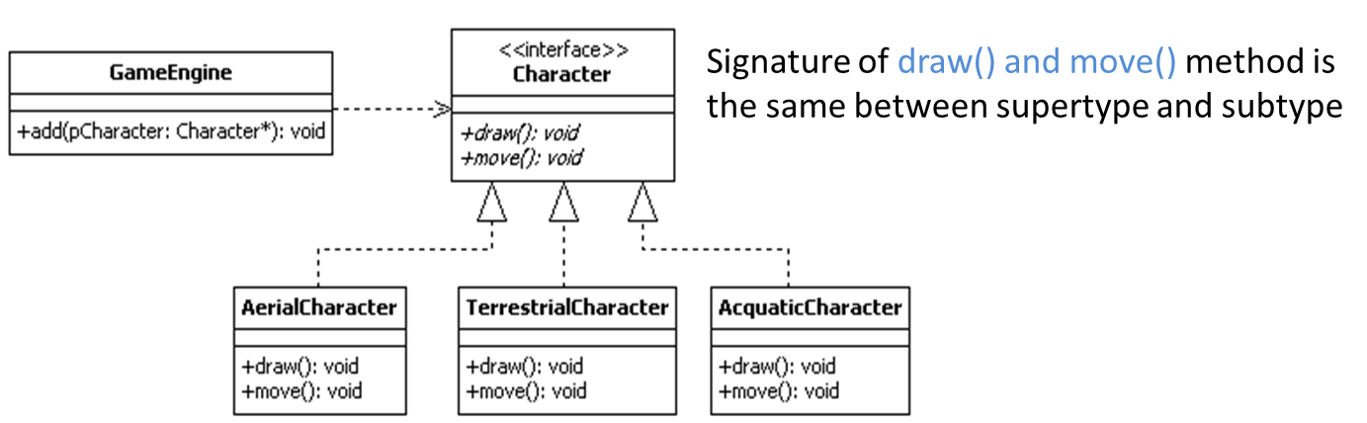
LISKOV SUBSTITUTION PRINCIPLE (LSP)
10

Slide 11

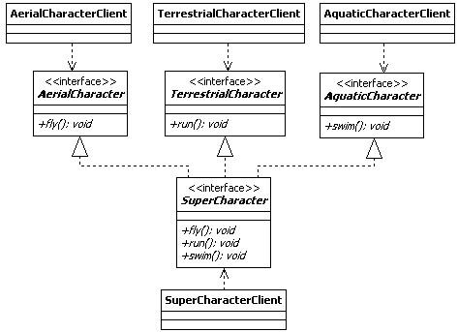
INTERFACE SEGREGATION PRINCIPLE (ISP)
The interface segregation principle (ISP) states that "clients should not be forced to depend on methods that they do not use“
The ISP implies that many client-specific interfaces are better than one general purpose interface
Smaller, specific interfaces are easier to maintain and reuse and lead to easier adherence to OCP and LSP
11

Slide 12

Thank you for your participation. I am very grateful to have the opportunity into this sharing session. If there any enquiries, feels free to contact me.
+013 509 9215
khatibsyarbini@utm.my

Slide 13

THANK YOU
In the Name of God for Mankind
univteknologimalaysia
utm.my
utmofficial

